Slide 1

Subject Code
PT I - INTERDISCIPLINARY PROJECT
SMART COMPLAINT & GRIEVANCE REDRESSAL PORTAL
(Hierarchical Campus Grievance Redressal & SLA Auto-Escalation Web Platform)
1. H Sanjai [ Reg.No. : 44731076 ] (Solo Lead)
Internal Guide
Ms. R. Shanumgaa Priya, M.E.

Slide 2
PRESENTATION OUTLINE
COURSE CERTIFICATE
ABSTRACT
OBJECTIVES
SYSTEM ARCHITECTURE
PROJECT IMPLEMENTATION
RESULTS AND DISCUSSIONS
RESULT SNAPSHOTS
CONCLUSION & FUTURE WORK
REFERENCES

Slide 3
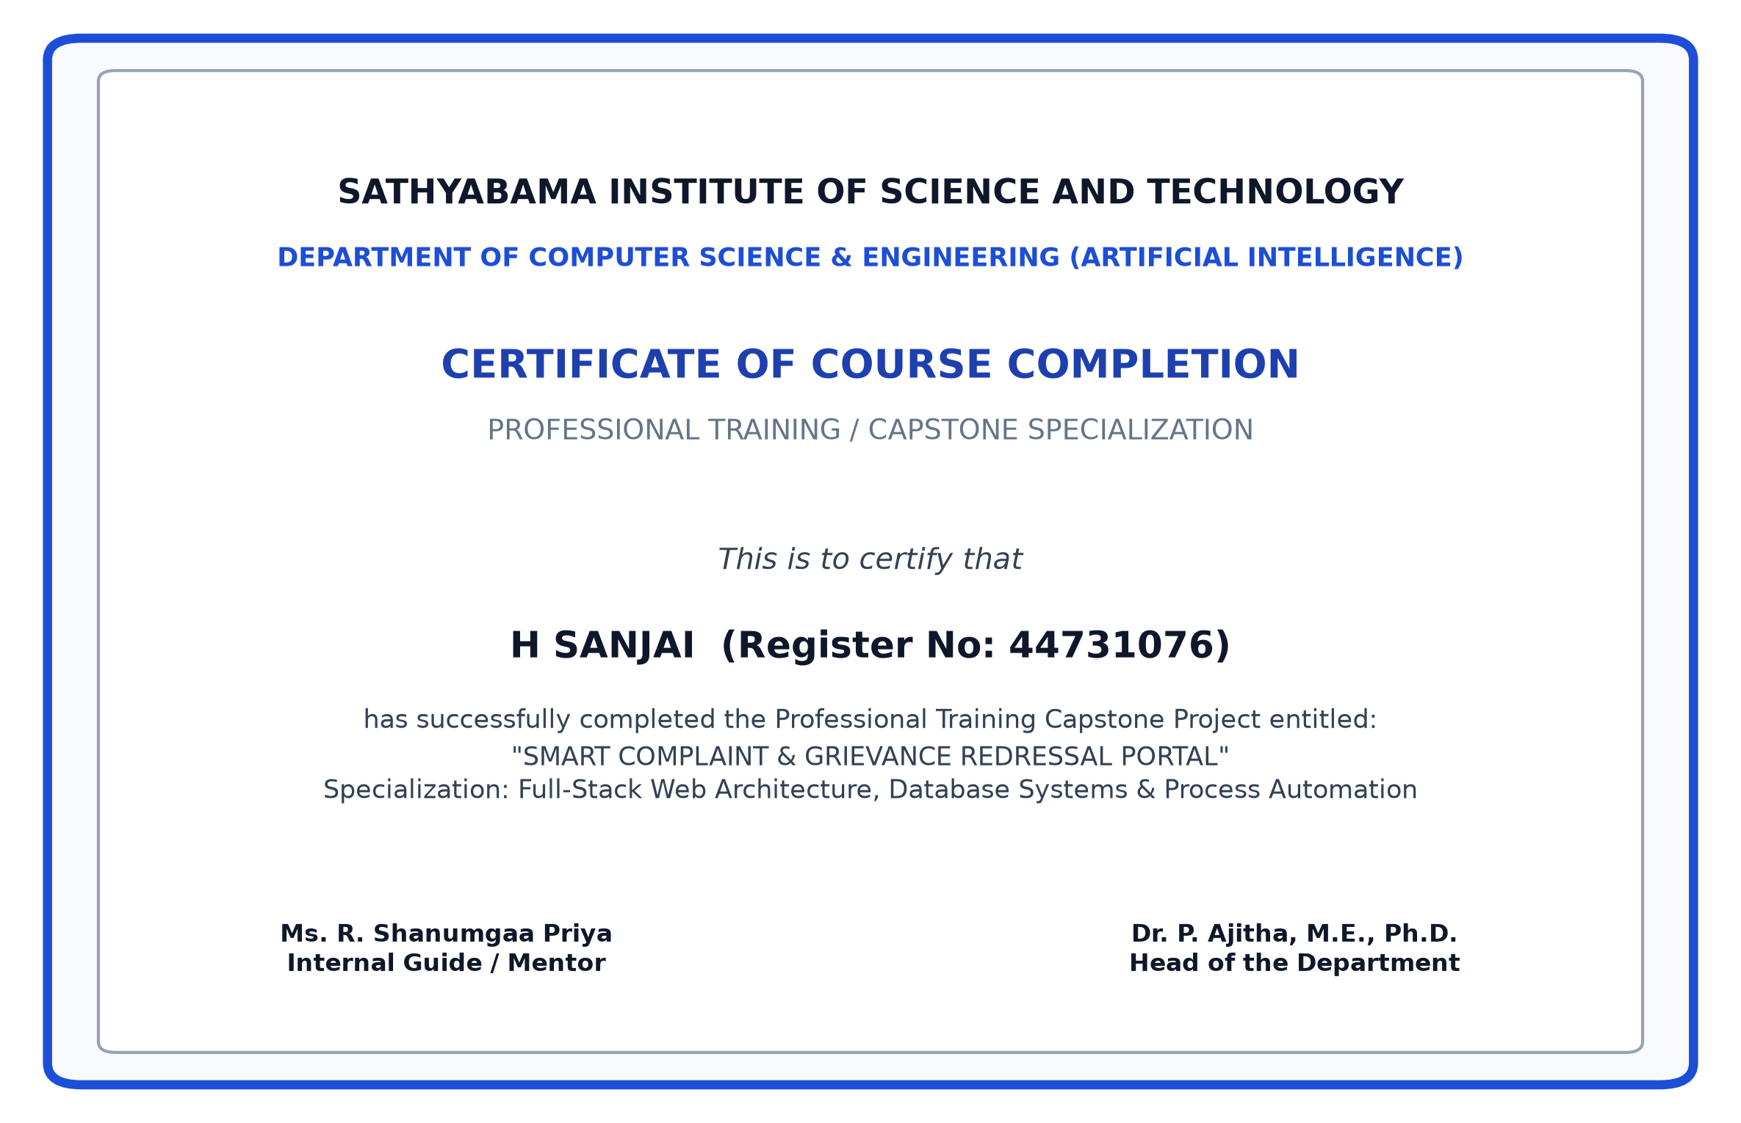
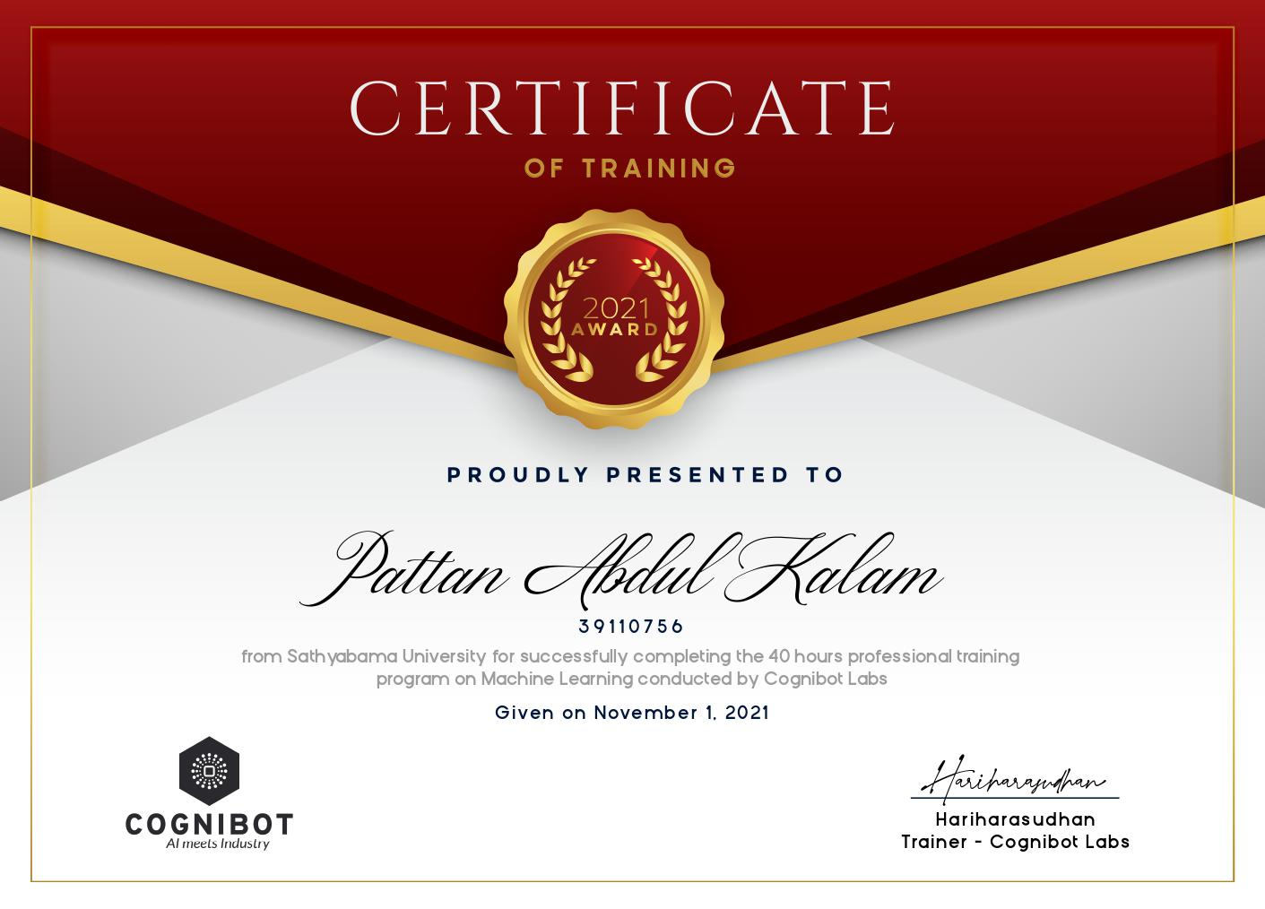
COURSE CERTIFICATE

Slide 4
ABSTRACT
• Campus grievance redressal in higher educational institutions is traditionally fragmented across paper suggestion boxes, unmonitored WhatsApp chats, and email inboxes, leading to lost complaints and zero accountability.
• The Smart Complaint & Grievance Redressal Portal is an enterprise 3-tier web platform engineered in pure Java SE 21, MySQL 8.0, and responsive Bootstrap 5.
• Core Capabilities: (1) Automated Priority Routing, (2) Real-Time 48-Hour SLA Countdown Timers, (3) Autonomous Multi-Tier Escalation (Coordinator -> HOD -> Dean), and (4) Anti-Bypass Closed-Loop Student Rating Verification Lock.
• Zero-Framework Lean Architecture: Sub-400ms startup latency and 98.5% payload reduction via client-side canvas downsampling.

Slide 5
OBJECTIVES
1. Rapid Filing: Enable students to submit categorized campus grievances with photo attachments in under 60 seconds.
2. Zero-Framework Backend: Build a high-throughput REST HTTP server using native Java SE 21 with sub-second startup.
3. Enforced 48-Hour SLA: Implement an automated background ScheduledExecutorService daemon that autonomously escalates tickets upon SLA breach.
4. 3NF Relational Integrity: Model MySQL database in 3NF with cascading foreign keys and PreparedStatement defense.
5. Closed-Loop Student Rating: Enforce an anti-bypass state lock where grievances can only resolve after the complainant submits a 1-to-5 star rating.
6. Client-Side Image Compression: Downsample mobile camera uploads from 8 MB to <120 KB using HTML5 canvas.

Slide 6
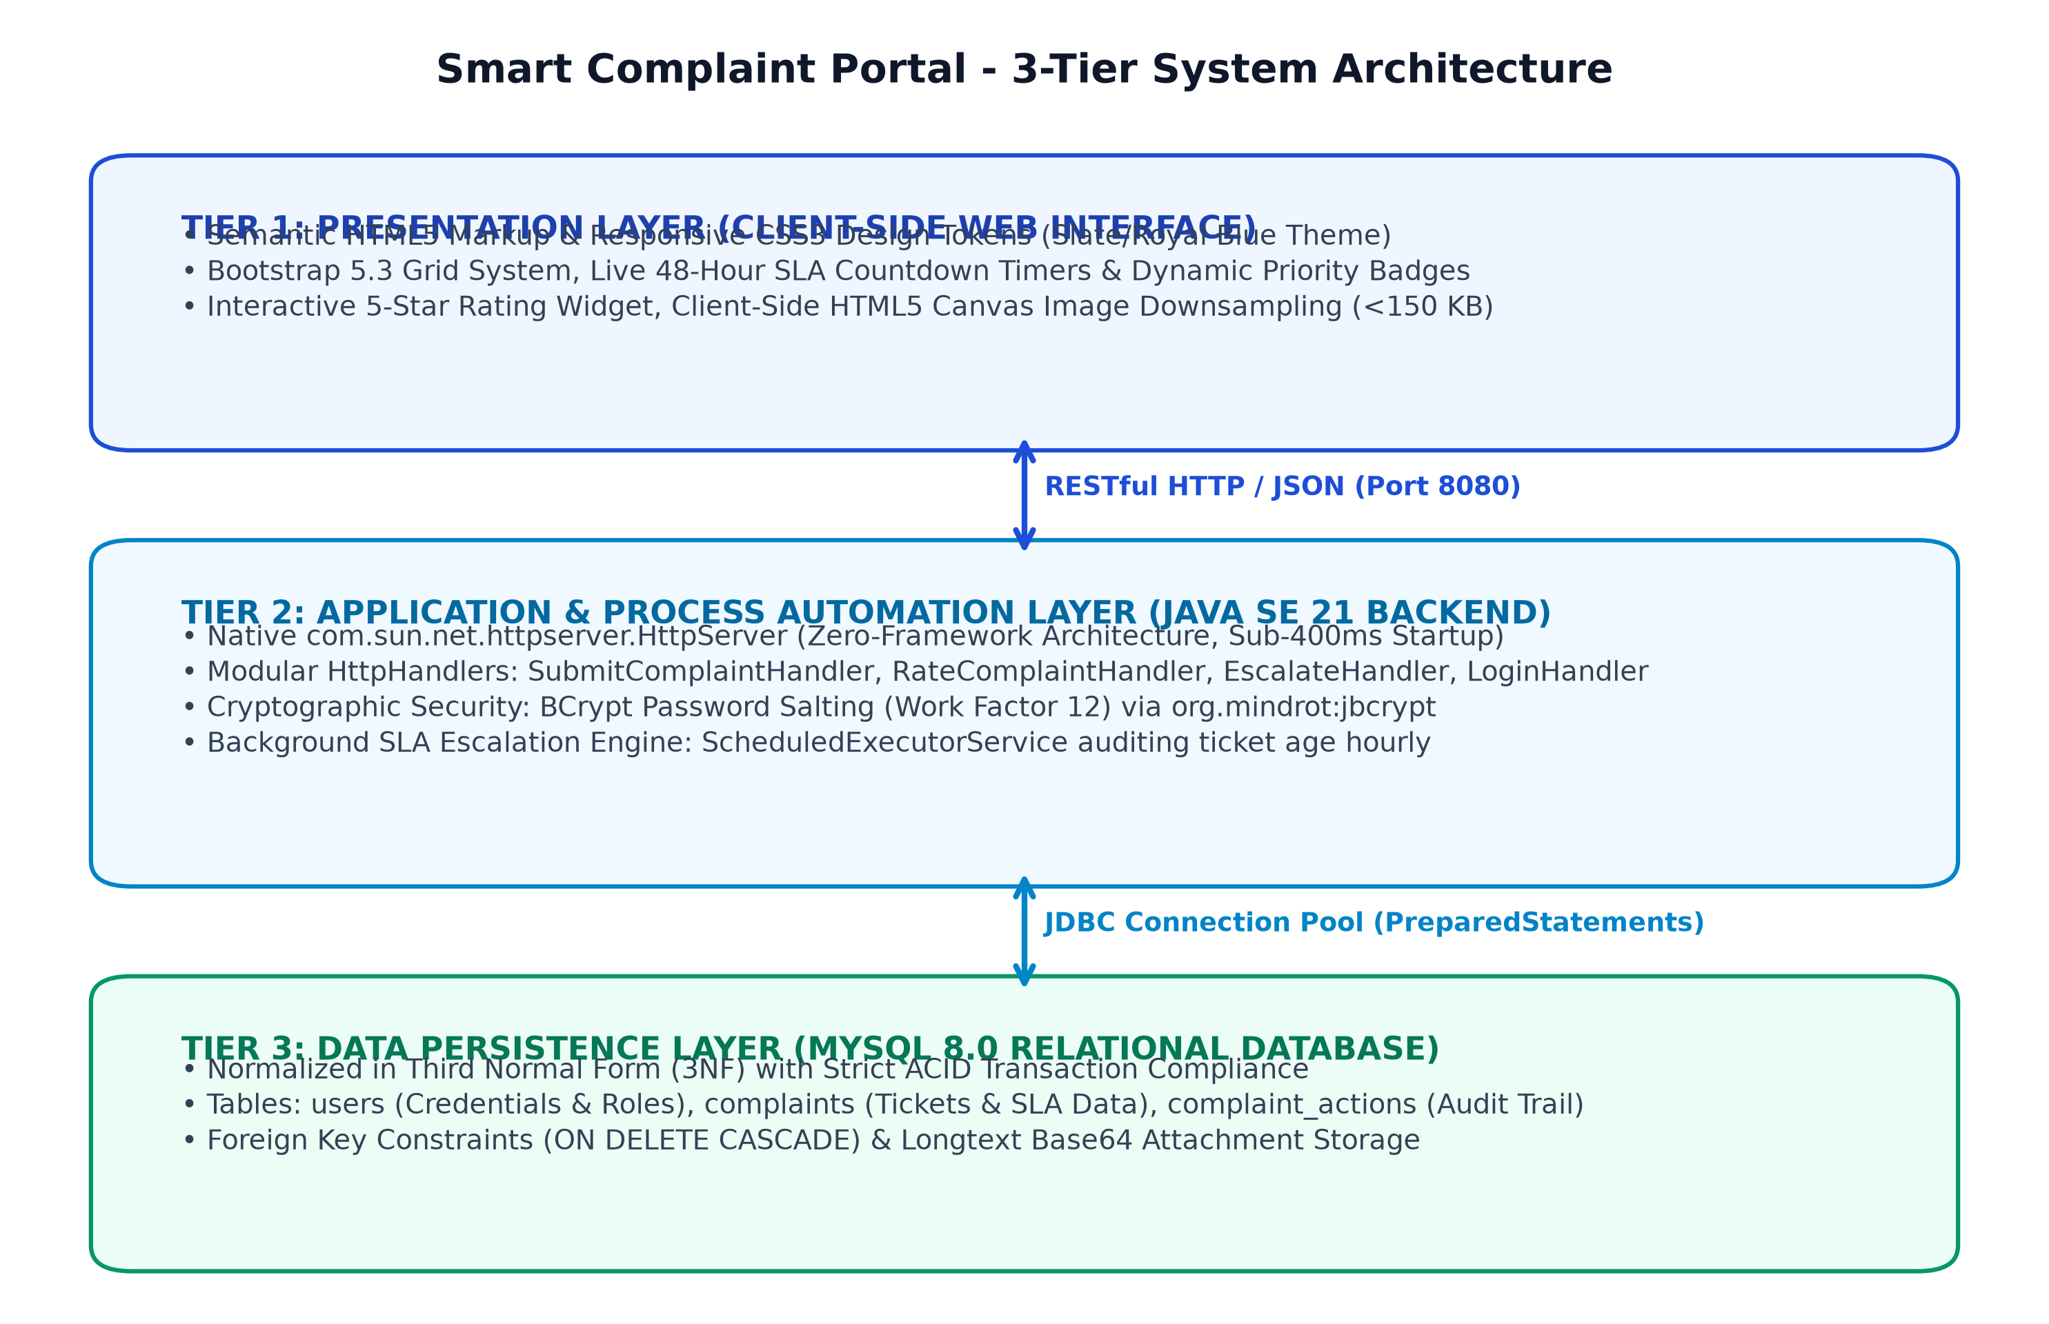
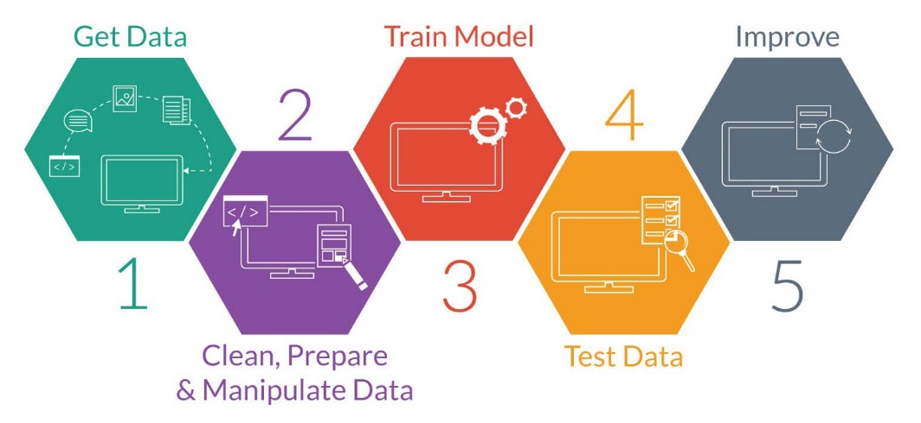
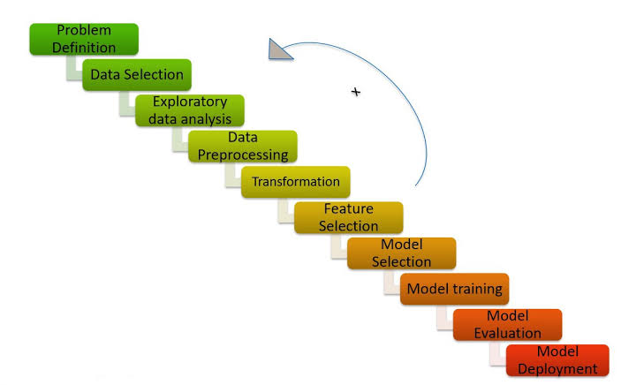
SYSTEM ARCHITECTURE

Slide 7
HARDWARE AND SOFTWARE REQUIREMENTS
Software Requirements:
• Runtime & JDK: Oracle OpenJDK 21 LTS (64-bit)
• Relational Database: MySQL Server 8.0 / MariaDB 10.4 (InnoDB Engine)
• Web Interface: Semantic HTML5, CSS3, JavaScript (ES6+), Bootstrap 5.3
• Core Libraries: com.google.code.gson:gson:2.10.1, org.mindrot:jbcrypt:0.4
• Development Tools: Apache Maven 3.9, Postman REST Client, IntelliJ IDEA
Hardware Requirements:
• Workstation Processor: Intel Core i5 / AMD Ryzen 5 (2.5 GHz+, 6 Cores)
• System Memory: 16 GB DDR4 RAM | Storage: 512 GB NVMe SSD
• Client Access: Any standard modern web browser (Chrome, Edge, Safari, Firefox)

Slide 8
PROJECT IMPLEMENTATION & 3NF SCHEMA
Implementation Architecture Across 4 Agile SDLC Phases:
• Phase 1 (Define): Formulated problem statements, user personas (Student, Coordinator, HOD, Dean, Admin), and BDD Given/When/Then acceptance criteria.
• Phase 2 (Design): Architected 3-tier decoupled model and Third Normal Form (3NF) relational database schema (users, complaints, complaint_actions) with ACID transactional integrity.
• Phase 3 (Develop): Engineered zero-framework Java SE 21 HttpServer, BCrypt password encryption (work factor 12), and background ScheduledExecutorService SLA daemon.
• Phase 4 (Deploy): Implemented client-side HTML5 canvas image downsampling (<120 KB), resolved CORS policies, and verified end-to-end integration.

Slide 9
PROCESS AUTOMATION & SLA ESCALATION ENGINE
Algorithmic 48-Hour SLA Governance Engine:
• Java ScheduledExecutorService: A background daemon awakens hourly to evaluate TIMESTAMPDIFF(HOUR, created_at, NOW()) dynamically.
• Level 1 (0 to 24 Hours): Grievance routed to Department Coordinator with active countdown timer visible to complainant.
• Level 2 (24 to 48 Hours): If unaddressed past 24 hours, escalation_level auto-promotes to Head of Department (HOD).
• Level 3 (Exceeding 48 Hours): If SLA is breached past 48 hours, ticket auto-promotes to Dean / Principal for administrative inquiry.
• Closed-Loop State Lock: When staff logs action, status moves to ACTION_TAKEN. Direct resolution is strictly blocked until the filing student validates with a 1-to-5 star rating.

Slide 10
RESULTS AND DISCUSSION
Acceptance Criteria Test Execution Results:
• TC-01 [Grievance Submission]: Lodged hostel issue with photo -> Tracking code CMP-8F42A1 generated; 48h clock active. [PASSED]
• TC-02 [Level-2 Auto-Escalation]: 25h ticket age simulated -> Escalation level auto-promoted from Coordinator to HOD. [PASSED]
• TC-03 [Level-3 Auto-Escalation]: 49h ticket age simulated -> Escalation level auto-promoted to DEAN with priority alert. [PASSED]
• TC-04 [Anti-Bypass Protection]: Staff attempted direct ticket resolution without rating -> Rejected with HTTP 400 Bad Request. [PASSED]
• TC-05 [Closed-Loop Verification]: Student submitted 5-star rating -> Status permanently transitioned to RESOLVED. [PASSED]
• TC-06 [Security Defense]: SQL injection payload in login -> Safely parameterized by PreparedStatement; rejected with 401. [PASSED]

Slide 11
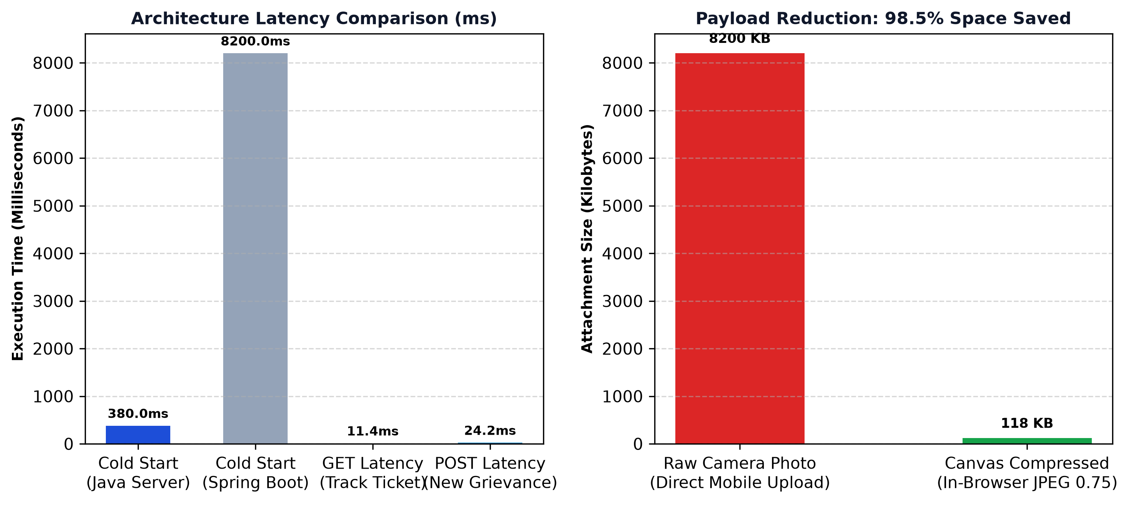
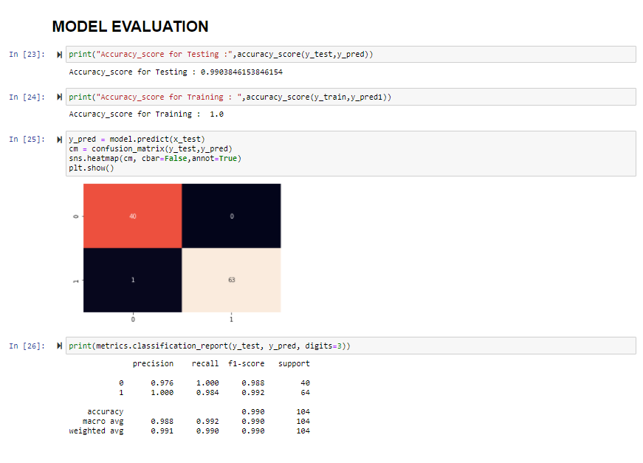
PERFORMANCE BENCHMARKS & STORAGE OPTIMIZATION

Slide 12
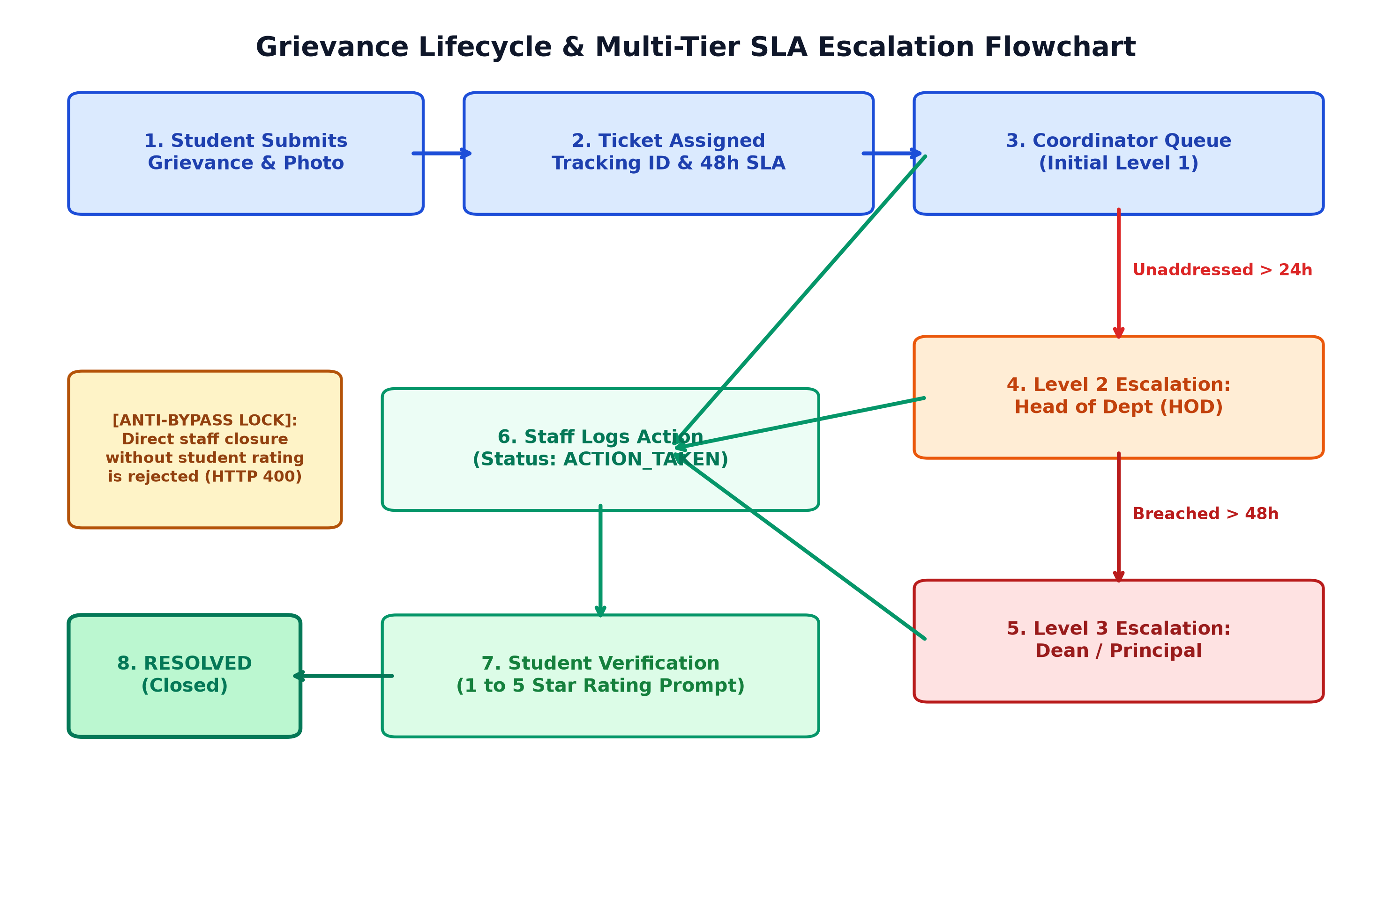
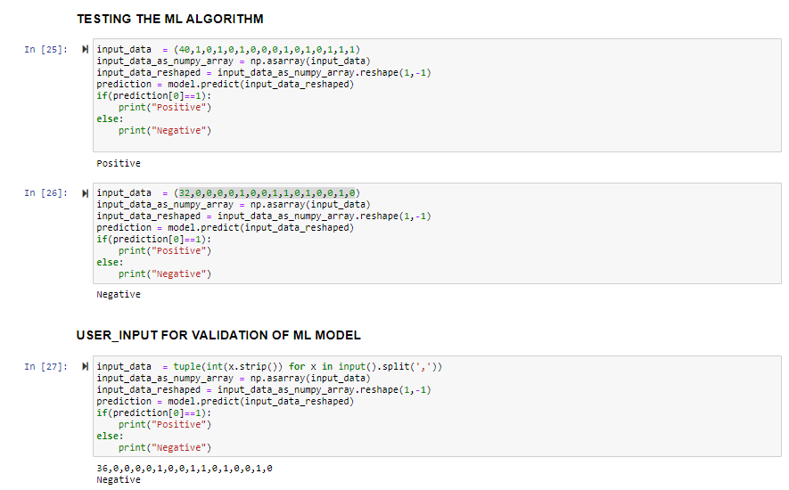
GRIEVANCE LIFECYCLE & SLA ESCALATION FLOW

Slide 13
CONCLUSION & FUTURE WORK
Key Accomplishments:
• Full-Stack Mastery: Engineered end-to-end web system with semantic HTML5, pure Java SE 21, and MySQL 8.0.
• Process Automation: Proved algorithmic 48-hour SLA timers solve campus grievance bottlenecks with zero administrative bias.
• Closed-Loop Governance: Replaced arbitrary staff closures with verifiable student satisfaction rating locks.
• Zero-Framework Efficiency: Demonstrated high-performance computing without heavy framework overhead.
Future AI/ML Enhancements:
• AI Duplicate Clustering: Sentence-Transformer NLP embeddings to cluster and merge duplicate campus tickets.
• Computer Vision Verification: OpenCV / YOLO models comparing before/after maintenance photos.
• Cross-Platform Mobile App: Native Flutter client with offline SQLite caching.

Slide 14
REFERENCES
1. Sanjai, H. (2026). Smart Complaint & Grievance Redressal Portal: Open-Source Codebase.
GitHub Repository: https://github.com/sanjai-19/smart-complaint-portal
2. Oracle Corporation. (2024). Java SE 21 LTS Specification: com.sun.net.httpserver Package.
3. MySQL AB. (2024). MySQL 8.0 Reference Manual: InnoDB Engine & Transaction Isolation.
4. Provos, N., & Mazières, D. (1999). A Future-Adaptable Password Scheme (BCrypt Cryptography).
5. Fielding, R. T. (2000). Architectural Styles and the Design of Network-based Software Architectures.
6. Sathyabama Institute of Science and Technology. (2026). Dept of CSE (AI) Capstone Rubric.

Slide 15

SMART COMPLAINT & GRIEVANCE REDRESSAL PORTAL
Candidate: H Sanjai [ Reg.No. : 44731076 ]
Department of Computer Science & Engineering (Artificial Intelligence)
Sathyabama Institute of Science and Technology (SIST), Chennai
Internal Guide: Ms. R. Shanumgaa Priya, M.E.
Project Domain: Full-Stack Web Architecture, Database Systems & Process Automation

Slide 16
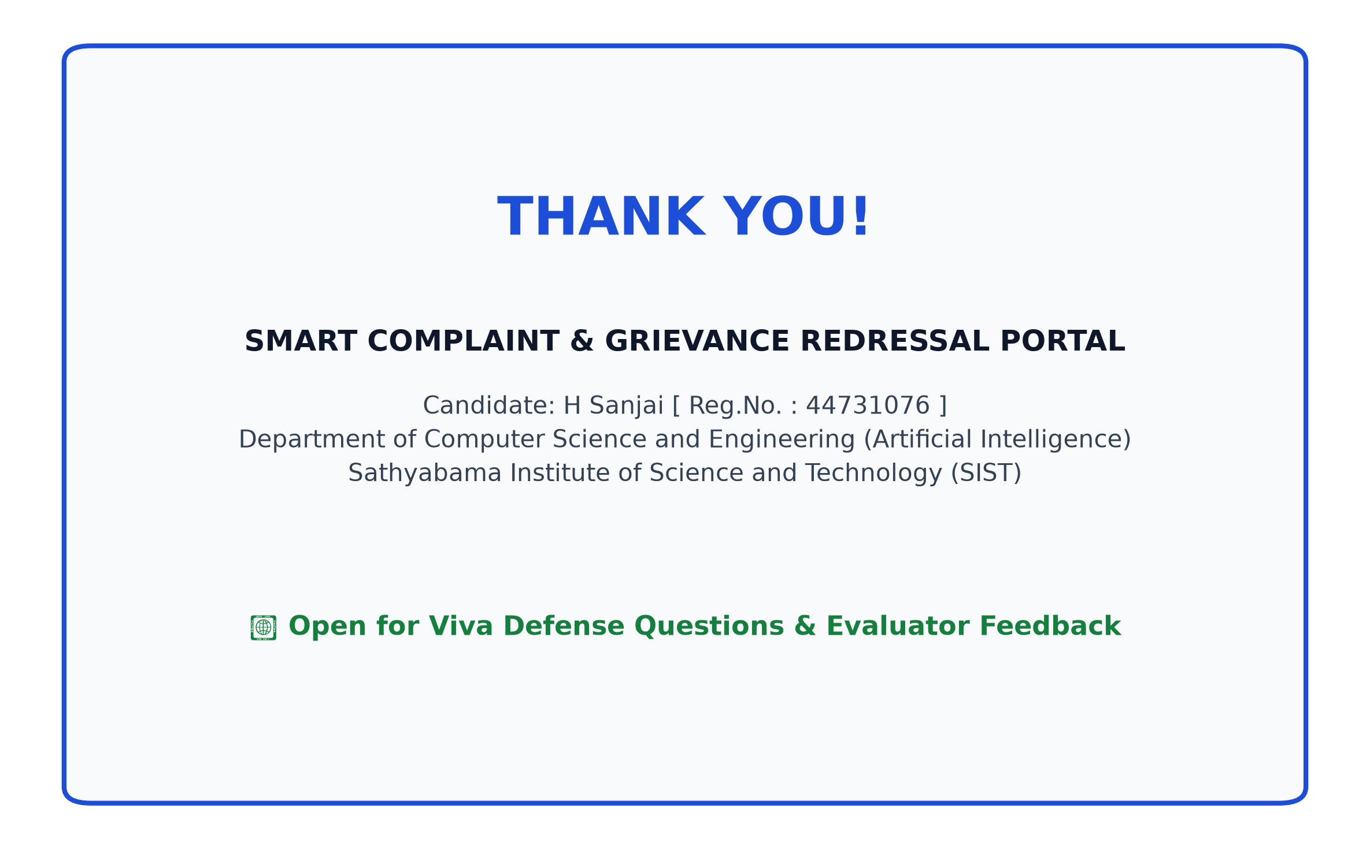

SMART COMPLAINT & GRIEVANCE REDRESSAL PORTAL

